Slide 1
Chapter 6
Arithmetic Instructions and Programs

Slide 2
Outlines
Range of numbers in 8051 unsigned data
Addition & subtraction instructions for unsigned data
BCD system of data representation
Packed and unpacked BCD data
Addition & subtraction on BCD data
Range of numbers in 8051 signed data
Signed data arithmetic instructions
Carry & overflow problems & corrections

Slide 3
Addition of Unsigned Numbers
ADD A, source ; A = A + source

Slide 4
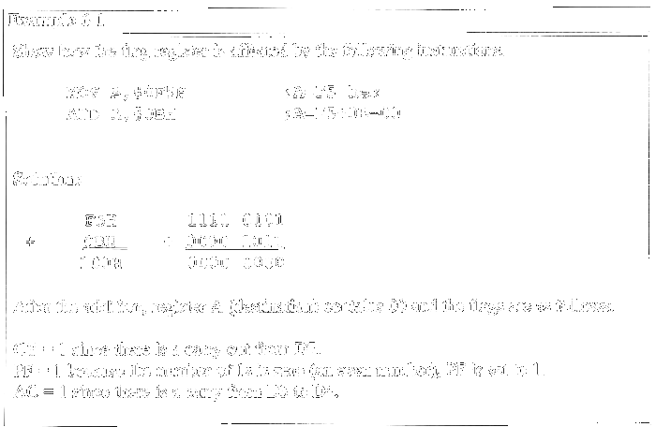

Slide 5
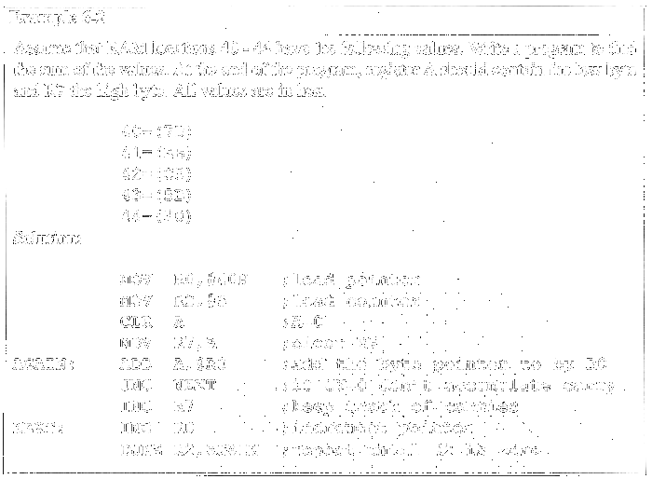
Addition of Individual Bytes

Slide 6
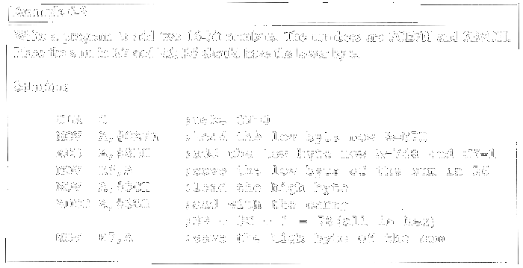
ADDC & Addition of 16-bit Numbers
1
3C E7
3B 8D
78 74
+

Slide 7
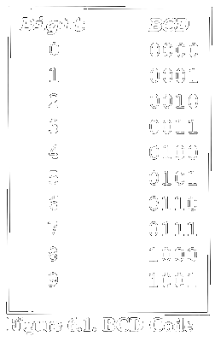
BCD Number System
Unpacked BCD: 1 byte
Packed BCD: 4 bits

Slide 8
Adding BCD Numbers & DA Instruction
MOV A,#17H
ADD A,#28H
MOV A,#47H ;A=47H first BCD operand MOV B,#25H ;B=25 second BCD operand
ADD A,B ;hex (binary) addition (A=6CH)
DA A ;adjust for BCD addition (A=72H)
HEX BCD
29 0010 1001
+ 18 + 0001 1000
41 0100 0001 AC=1
+ 6 + 0110
47 0100 0111

Slide 9
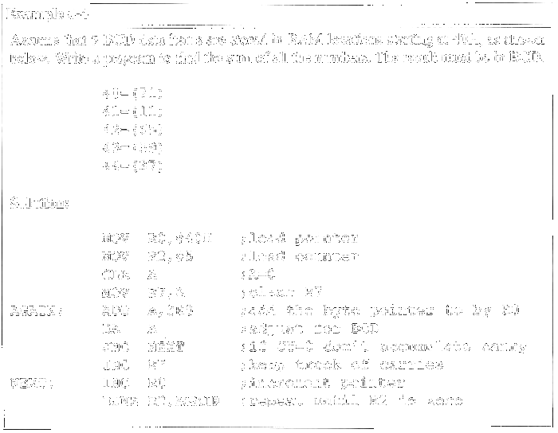
Example

Slide 10
Subtraction of Unsigned Numbers
SUBB A, source ; A = A – source – CY
SUBB when CY = 0
  Take 2’s complement of subtraend (source)
  Add it to minuend
  Invert carry

Slide 11
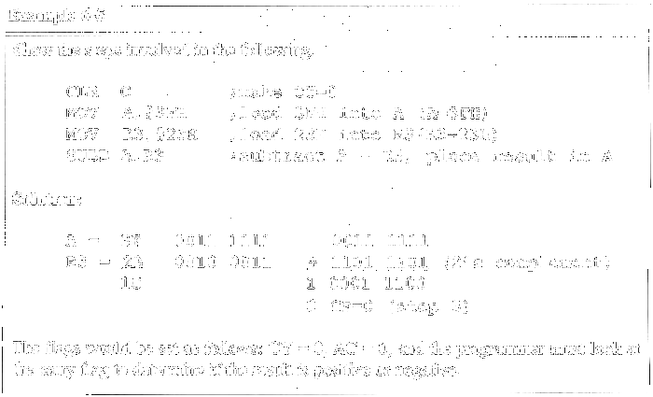
Example (Positive Result)

Slide 12
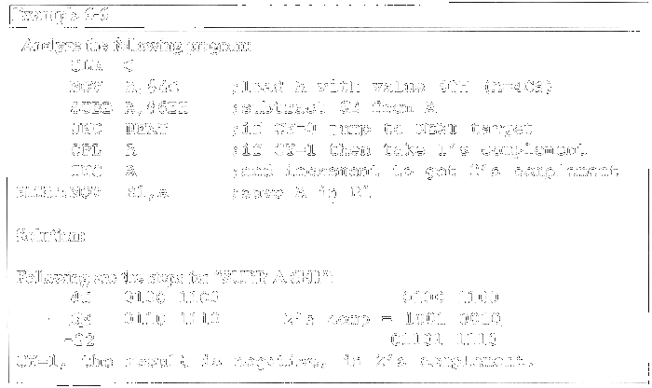
Example (Negative Result)

Slide 13
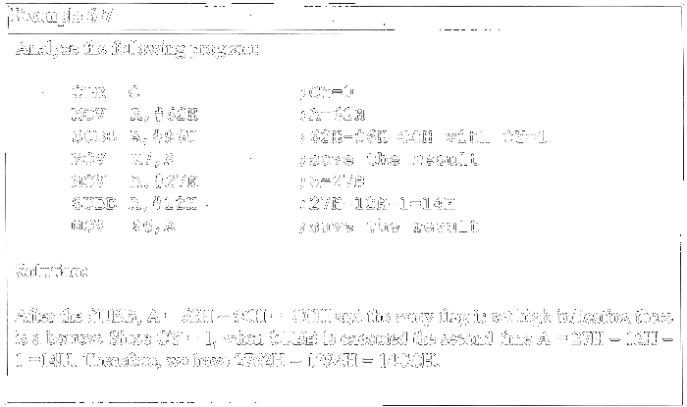
SUBB When CY = 1
For multibyte numbers

Slide 14
Multiplication of Unsigned Numbers
MUL AB ; A × B, place 16-bit result in B and A
MOV A,#25H ;load 25H to reg. A
MOV B,#65H ;load 65H in reg. B
MUL AB ;25H * 65H = E99 where
;B = 0EH and A = 99H
Table 6-1:Unsigned Multiplication Summary (MUL AB)
Multiplication | Operand 1 | Operand 2 | Result
byte × byte | A | B | A=low byte, B=high byte

Slide 15
Division of Unsigned Numbers
DIV AB ; divide A by B
MOV A,#95H ;load 95 into A
MOV B,#10H ;load 10 into B
DIV AB ;now A = 09 (quotient) and
;B = 05 (remainder)
Table 6-2:Unsigned Division Summary (DIV AB)
Division | Numerator | Denominator | Quotient | Remainder
byte / byte | A | B | A | B

Slide 16
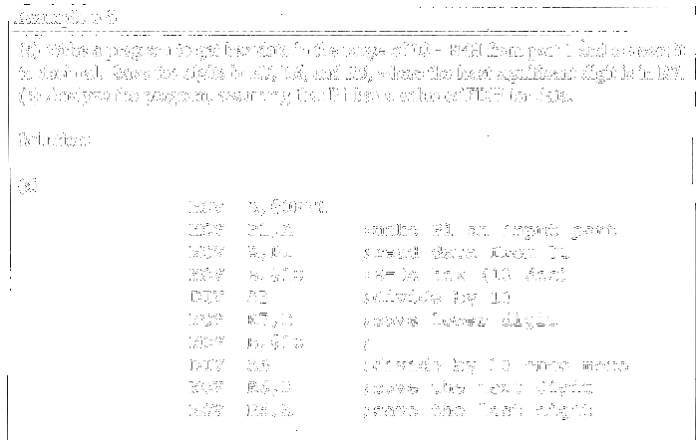
Example ( 1 of 2 )

Slide 17
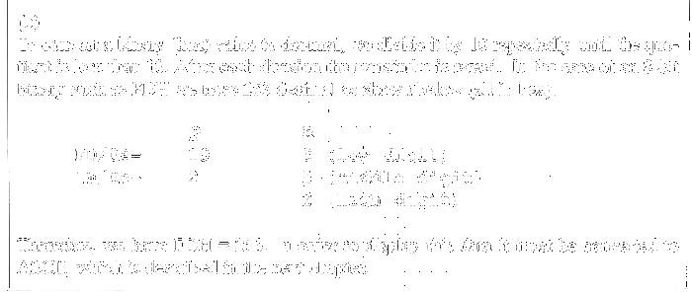
Example ( 2 of 2 )

Slide 18
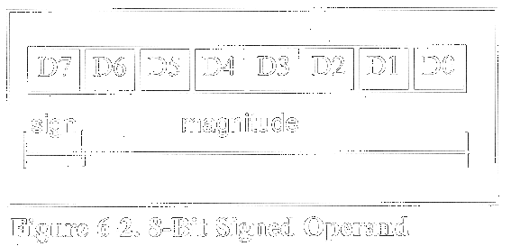
Signed 8-bit Operands
Covert to 2’s complement
  Write magnitude of number in 8-bit binary (no sign)
  Invert each bit
  Add 1 to it

Slide 19
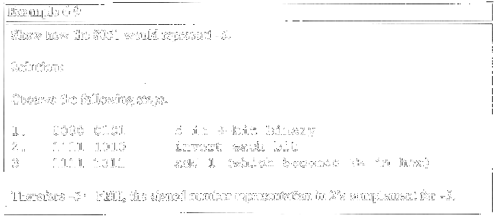
Example

Slide 20
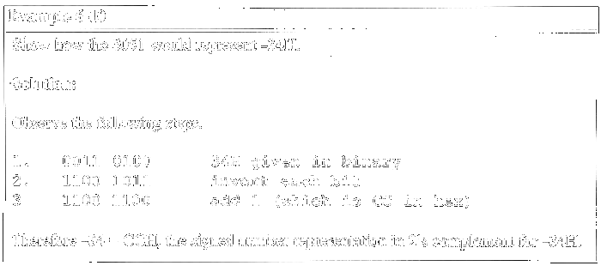
Example

Slide 21
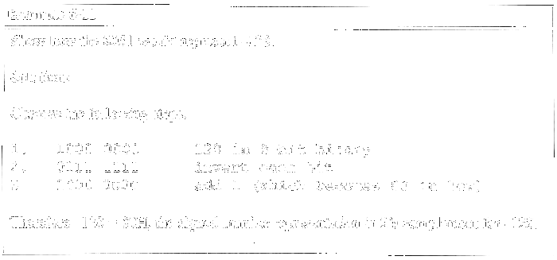
Example

Slide 22
Byte-sized Signed Numbers Ranges
Decimal Binary Hex
-128 1000 0000 80
-127 1000 0001 81
-126 1000 0010 82
…. ………… ..
-2 1111 1110 FE
-1 1111 1111 FF
0 0000 0000 00
+1 0000 0001 01
+2 0000 0010 02
… ………… ...
+127 0111 1111 7F

Slide 23
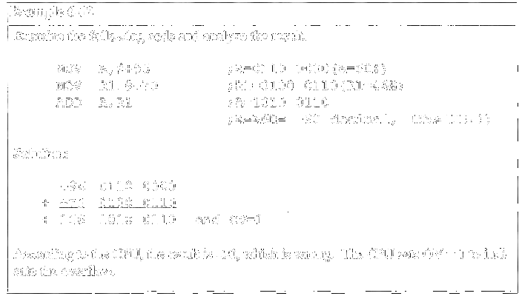
Overflow in Signed Number Operations

Slide 24
When Is the OV Flag Set?
Either: there is a carry from D6 to D7 but no carry out of D7 (CY = 0)
Or: there is a carry from D7 out (CY = 1) but no carry from D6 to D7

Slide 25
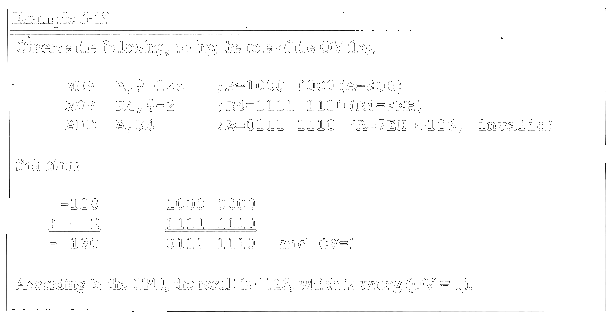
Example

Slide 26
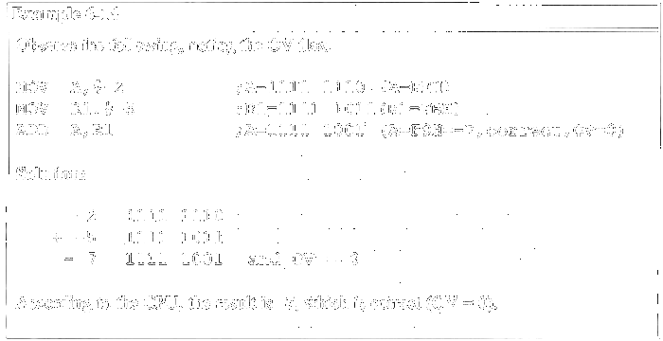
Example

Slide 27
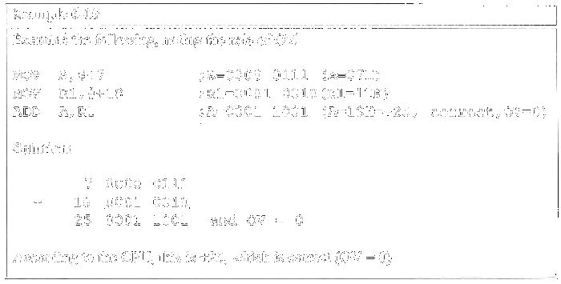
Example

